Slide 1
A History of Lewis and Clark School
An Inquiry into Where We Are in Place and Time by Mrs. Meurer’s First and Second Grade Class, 2013-2014
Our Big Question: What makes communities change over time?

Slide 2
1954 In the beginning…
by Emmett

Slide 3
1954 How and Why Our School Was Built
by Cazden and Maddox

Slide 4
The Grand Opening of Our School
by Sydney and Malanna

Slide 5
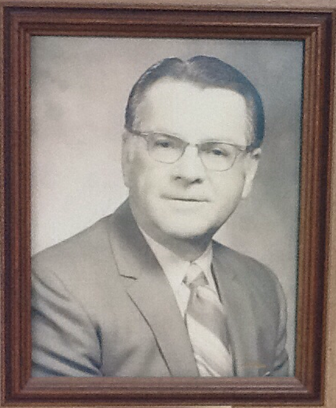
1955 Our First Principal, George Hall
By River and Grady

Slide 6
1957 What Our School Was Like
By River and Grady

Slide 7
1960 Can You Spot Ms. Anderson?
By Olivia and Mayana

Slide 8
1967 Can You Spot Her Again?
By Olivia and Mayana

Slide 9
1957 The Stage! What Happened to It?
By Henri

Slide 10
1960’s Where Did Kids Eat Lunch?
By Mayana

Slide 11
Now Where Do We Eat?
By Mayana

Slide 12
What Was Our Mascot?
By Hailey and Ellie

Slide 13
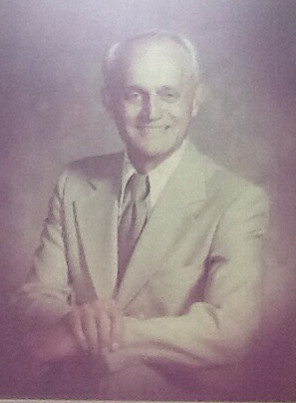
1970-1977 Ben Hansen
By River and Grady

Slide 14
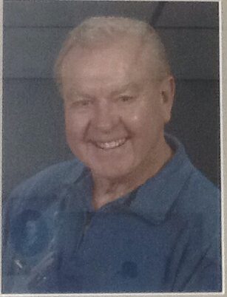
1977-1982 Our Third Principal, Darrell Peterson
By River and Grady

Slide 15
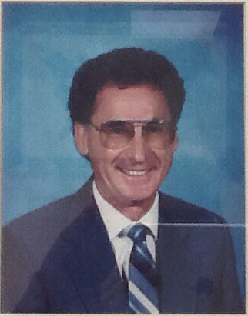
1982-1992 Our Fourth Principal, Glenn Kozeluh
By River and Grady

Slide 16
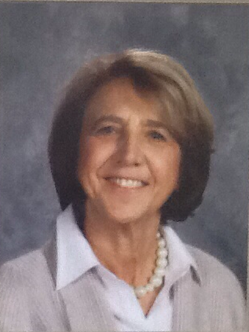
1992-2009 Karen Allen, Our Fifth Principal
By Gemma

Slide 17
1997 Why Was the Outdoor Discovery Core built?
By Aviv and Maddox

Slide 18
2002 How Was the Outdoor Discovery Core Built?
By Aviv and Maddox

Slide 19
2008 Why Was the Peace Path Built?
By Cedar, Talia, Sydney

Slide 20
2008 How Was the Peace Path Built?
By Cedar, Talia, Sydney

Slide 21
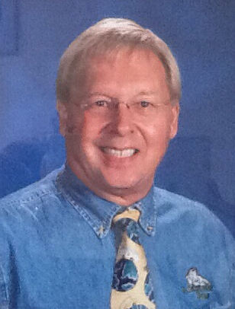
2009 Mr. Sturgis Becomes Our 6th Principal
By Gemma, Boone, Olivia

Slide 22
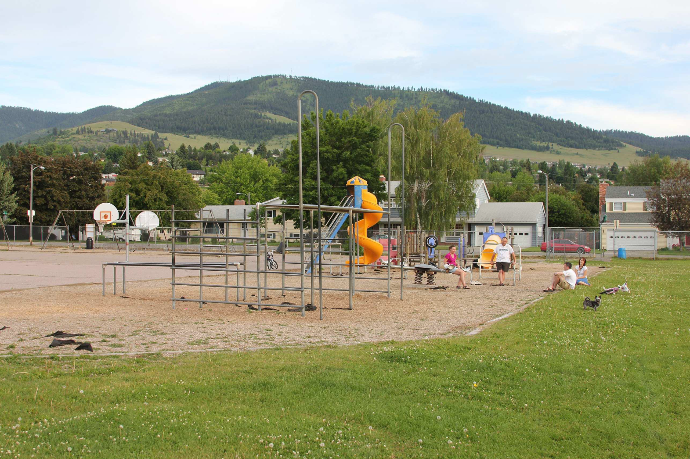
2011 Why Was the New Playground Built?
By Aiden and Liam

Slide 23
2013 How and Why Was the New Playground Built?
By Aiden and Liam

Slide 24
2013 Ms. Anderson Becomes Our 7th Principal
By Henri and Finn

Slide 25
2013 How and Why Were the Entrance Gardens Built?
By Malanna and Cedar

Slide 26
2013 What Is Our School Like Now?
By Talia and Aviv

Slide 27
2013 What is Our Mascot Now?
By Ellie and Hailey

Slide 28
So, how and why do communities change?
Communities change when…
More people move to a place!
People make a better choice!
People start jobs or retire!
People want to make it a better place!
People want to make it a safer place!

